Slide 1

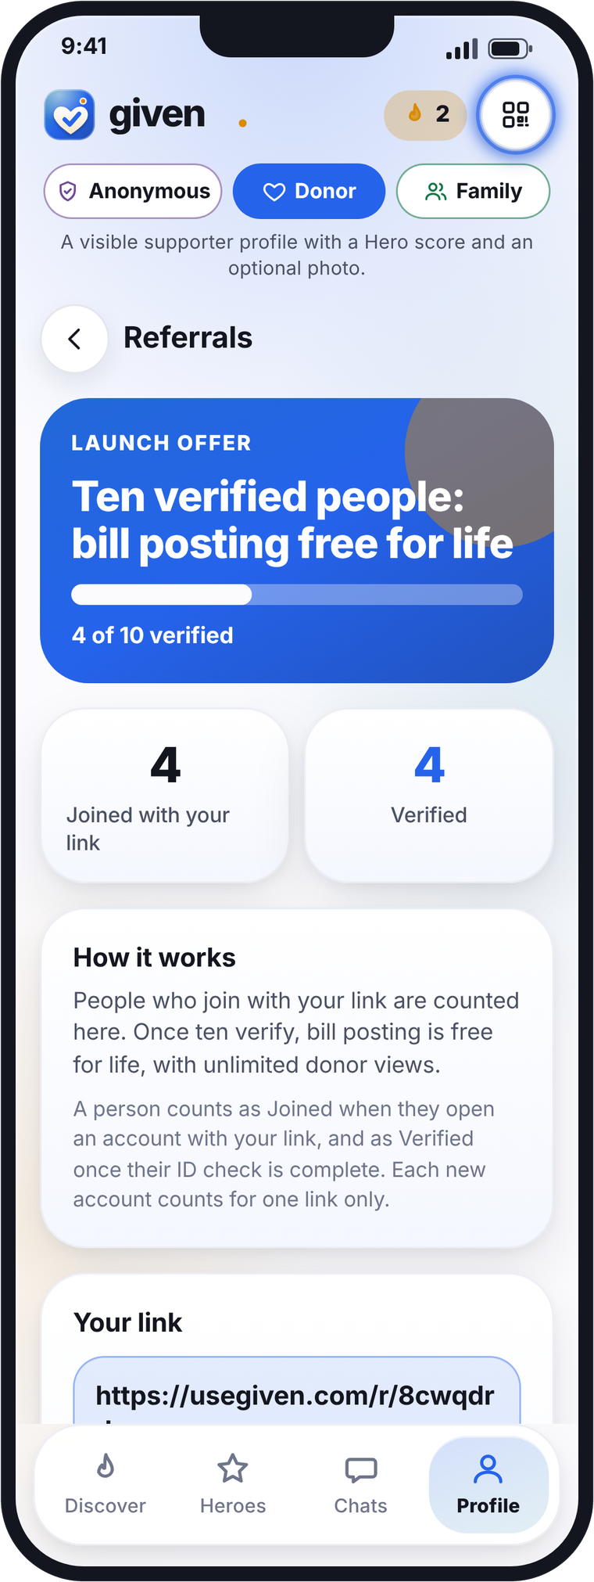
Partner calculator
What could you earn?
$3 for every verified member, plus 20% of every rent and bill fee they pay. Rent is where the money is.
In PowerPoint: Double-click the calculator on slide 2 and change the yellow cells.
Charts: Right-click a chart, choose Edit Data, and change the yellow cells.
Anywhere: usegiven.com/calculator
Illustrative examples, not guaranteed earnings. Rates to be agreed.
Notes:
Partner calculator deck, US dollars. Slide 2 holds an embedded Excel workbook (double-click in PowerPoint to edit). Charts on slides 4 to 6 are native charts whose data sheet contains the same calculator with formulas (right-click > Edit Data). Web version: https://usegiven.com/calculator/

Slide 2

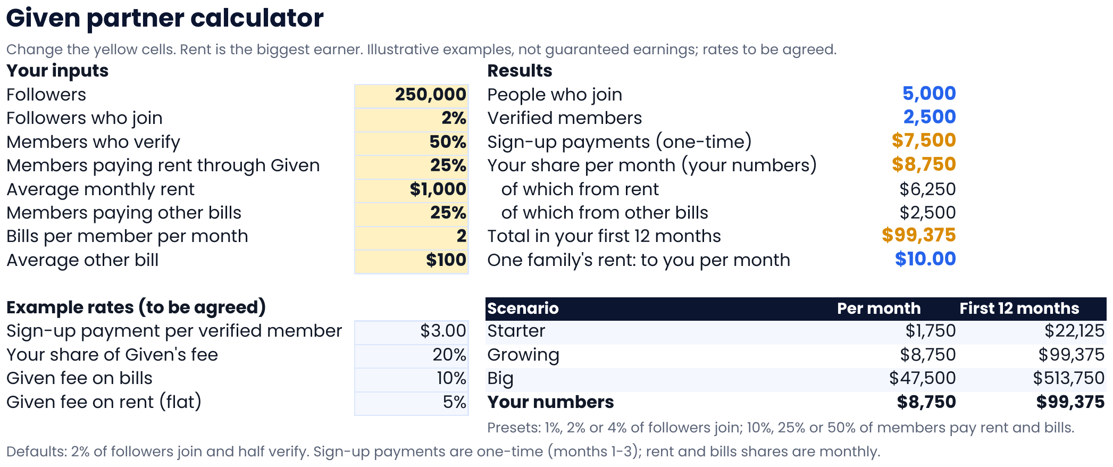
given
On any device: usegiven.com/calculator
Your calculator
Double-click the sheet, change the yellow cells, then click outside it. Shown: 250,000 followers, Growing preset (2% join, half verify).
Illustrative examples, not guaranteed earnings. Rates to be agreed.
2
Notes:
Embedded Excel workbook. Inputs on the Calculator sheet (B4:B11: followers, join %, verify %, rent share, average rent, bills share, bills per month, average bill), example rates (B14:B17: $3, 20%, 10% bills, 5% rent), results (E4:E11), presets (D14:F17). Formulas on the Model sheet. No caps anywhere: every share can go to 100%.

Slide 3
given
Your numbers at a glance
Growing preset, 250,000 followers. In the macro-enabled copy, Update numbers refreshes this slide and every chart.
Total earned in your first 12 months
$99,375
$7,500
$65,625
$26,250
one-time sign-ups
rent share
bills share
250,000
5,000
2,500
$8,750
$6,250
$2,500
followers
people join (2%)
verified (50%)
your share per month
from rent, per month
from bills, per month
Update numbers
Needs the GivenCalculator macro (see slide 7). Without it, use slide 2 or the web calculator.
Illustrative examples, not guaranteed earnings. Rates to be agreed.
3
Notes:
Text boxes named calc_year1, calc_y1_signup, calc_y1_rent, calc_y1_other, calc_followers, calc_joined, calc_verified, calc_month, calc_rent, calc_other are updated by the VBA macro UpdateNumbers (Given_Calculator.bas). The button runs that macro only in a macro-enabled .pptm that contains it.

Slide 4
given
Your share per month
Monthly share once members are active. Presets: 1%, 2% or 4% of followers join. Rent leads.
Rent: one $1,000 rent paid
$10 a month to you
Other bills: one $100 bill paid
$2 to you
Given's fee
5% of rent, 10% of bills
Illustrative examples, not guaranteed earnings. Rates to be agreed.
4
Notes:
Native stacked column chart. Series values are formulas: Model!D2:D5 (rent) and Model!E2:E5 (other bills), driven by the Calculator sheet inputs in the chart's data workbook.

Slide 5
given
Month by month in your first year
$ earned each month, your numbers. One-time sign-up payments arrive in months 1 to 3 while your monthly share builds up; from month 4 it holds steady.
one-time sign-ups end here
Illustrative examples, not guaranteed earnings. Rates to be agreed.
5
Notes:
Native stacked column chart. Series values: Model!J9:L20 (sign-up payments, rent share, bills share for your numbers), month by month. Why the step after month 3: the one-time $3 sign-up payments are paid as members verify over months 1-3 (a third each month), while the share of members paying rent and bills builds 25%, 50%, 75%, then 100% from month 4. So month 3 is a little higher than the steady months that follow.

Slide 6
given
Sign-ups only, or with the monthly share
$ earned in year 1. Grey: one-time sign-up payments only. Gold: plus 12 months of rent and bills share.
Illustrative examples, not guaranteed earnings. Rates to be agreed.
6
Notes:
Native clustered column chart. Values: Model!H2:H5 (sign-ups only) and Model!G2:G5 (year 1 total).

Slide 7
given
How you earn
Three steps. The more your members pay through Given, the more you earn, every month.
1
Share your link
Macro version
Your followers join Given with your link, code or QR.
In PowerPoint: Alt+F11, File, Import, choose Given_Calculator.bas, then save as a macro-enabled presentation (.pptm).
The Update numbers button on slide 3 then refreshes the numbers and charts.
2
$3 for every verified member
Paid once each person passes the ID and face check.
20% of our fee, every month
On any device: usegiven.com/calculator
3
$10 on every $1,000 rent and $2 on every $100 bill your members pay.
Book a call: usegiven.com/join/#book
Illustrative examples, not guaranteed earnings. Rates to be agreed.
7
Notes:
How it is worked out: people who join = followers × join rate; verified = join × verify rate (whole people); sign-ups = verified × $3, paid over months 1-3; rent share per month = verified × share paying rent × 5% of average rent × 20%; bills share per month = verified × share paying bills × bills a month × average bill × 10% × 20%; members paying build up 25%, 50%, 75% in months 1-3, all from month 4. Matches model.py, the web calculator and the workbook (tested, including 100% shares and $2,500 and $5,000 rent).

Slide 8
given
Posting plan and niches: bonuses to unlock
Two tracks
Every platform
One lane
Starter: a one-time payment per verified member. Post 3 times a week to unlock +25% on sign-ups.
Which platforms are you on? TikTok, Instagram, YouTube.
Rent: the main lane and biggest earner. Students, young renters and their parents.
Partner: a share of rent and bill fees every month. Post 5 days a week plus a short monthly review call to unlock the top rate. On a break, you keep a base rate.
Post once per platform: +10% for 2 platforms, +20% for all 3.
Bills: for money-saving creators.
Weekly leaderboard and a monthly prize for the top poster.
Generous supporters: lifestyle creators whose audiences love to help. Family-friendly, always.
Illustrative. Bonuses and rates to be agreed in writing. Bonuses are not included in the calculator.
8
Notes:
Posting plan and niches (to be agreed). Two tracks: Starter (one-time per verified member; 3 posts a week unlocks +25% on sign-ups) and Partner (share of rent and bill fees; 5 days a week plus a short monthly review call unlocks the top rate; base rate during a pause). Platforms: TikTok, Instagram, YouTube; +10% for 2, +20% for 3; weekly leaderboard, monthly top-poster prize. Niches: rent (main), bills, generous supporters (neutral, family-friendly).

