Slide 1
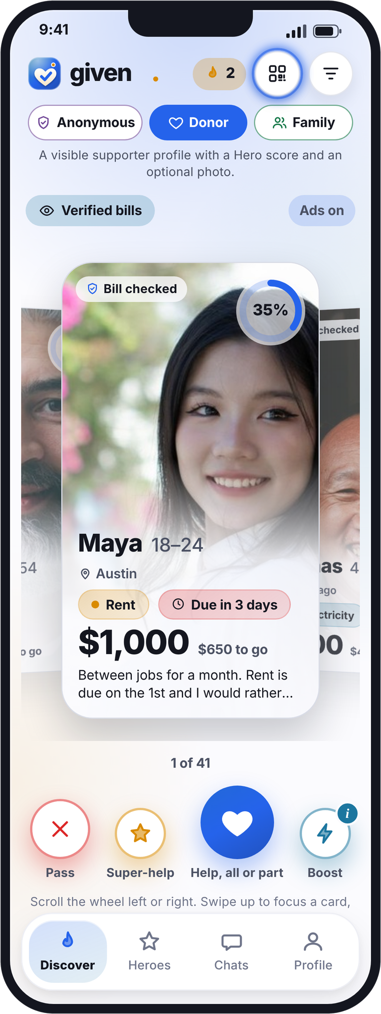

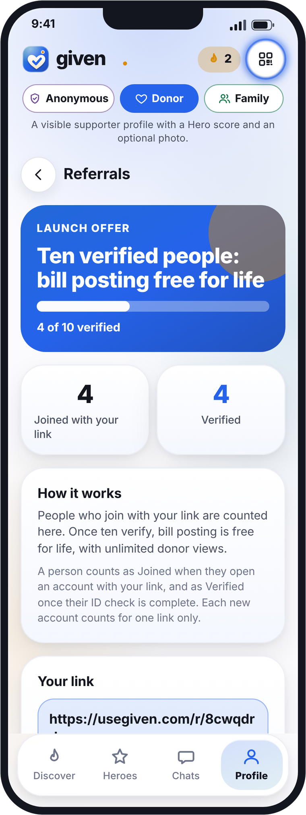
Partner program
Grow with Given
Earn every month when your community helps each other with real bills, starting with rent.
usegiven.com
Notes:
Partner presentation for US creators and influencers. All amounts in US dollars. Phones: Discover and Referrals screens of the Given app.

Slide 2

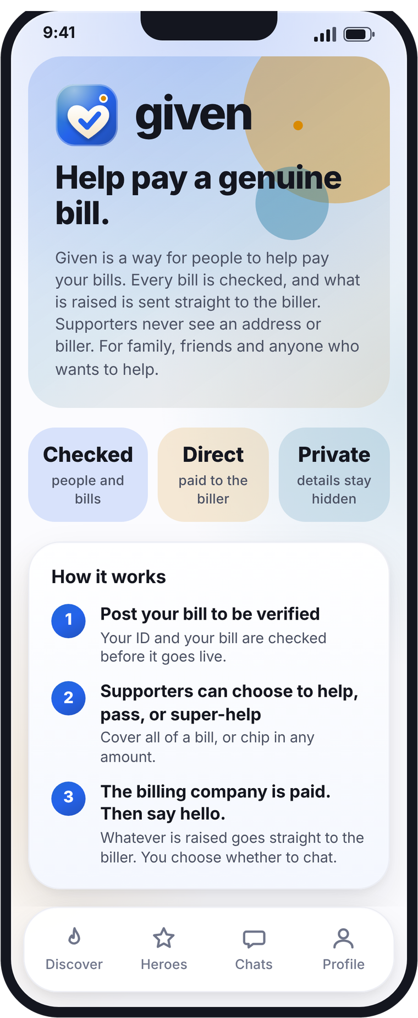
given
A simple way for people to help pay your bills
1
Post a real bill
Rent, phone, utilities and more. Your ID and the bill are checked first.
2
Supporters help
Family, friends and kind strangers choose to help, pass or super-help.
3
Paid straight to the biller
Money goes to the landlord or company through a licensed payments partner, never to a person.
2
Notes:
What Given is, from the app's About screen: post your bill to be verified; supporters can help, pass or super-help; the biller is paid through a licensed payments partner. Whatever is raised goes straight to the biller.

Slide 3
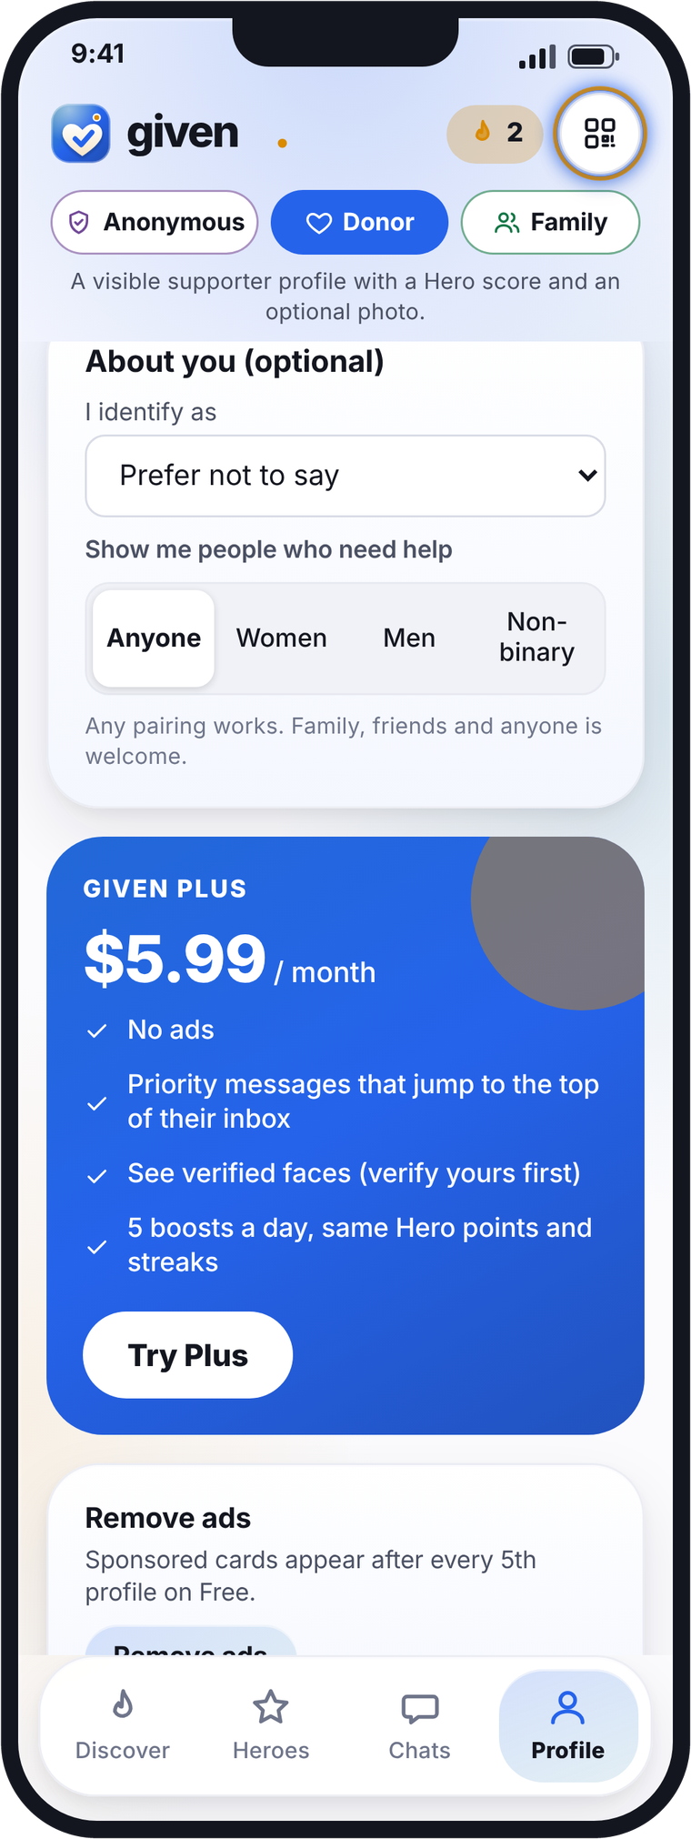
given
Why your followers share it
Everyone has bills, and rent is the biggest. Given makes asking for help simple and safe.
Rent, every month
Help that is real
Families and sponsors can cover all or part of someone's rent, month after month.
Every person and every bill is checked. Money goes straight to the biller.
Easy to pass on
Launch offer
Each member gets their own link, code and QR code to invite others.
Invite ten people who verify: bill posting free for life, unlimited donor views.
3
Notes:
Why followers share: real bills led by rent, verification, paid to the biller, own referral link, code and QR, and the launch offer (ten verified people, bill posting free for life, unlimited donor views). Phone: Profile with referral card.

Slide 4
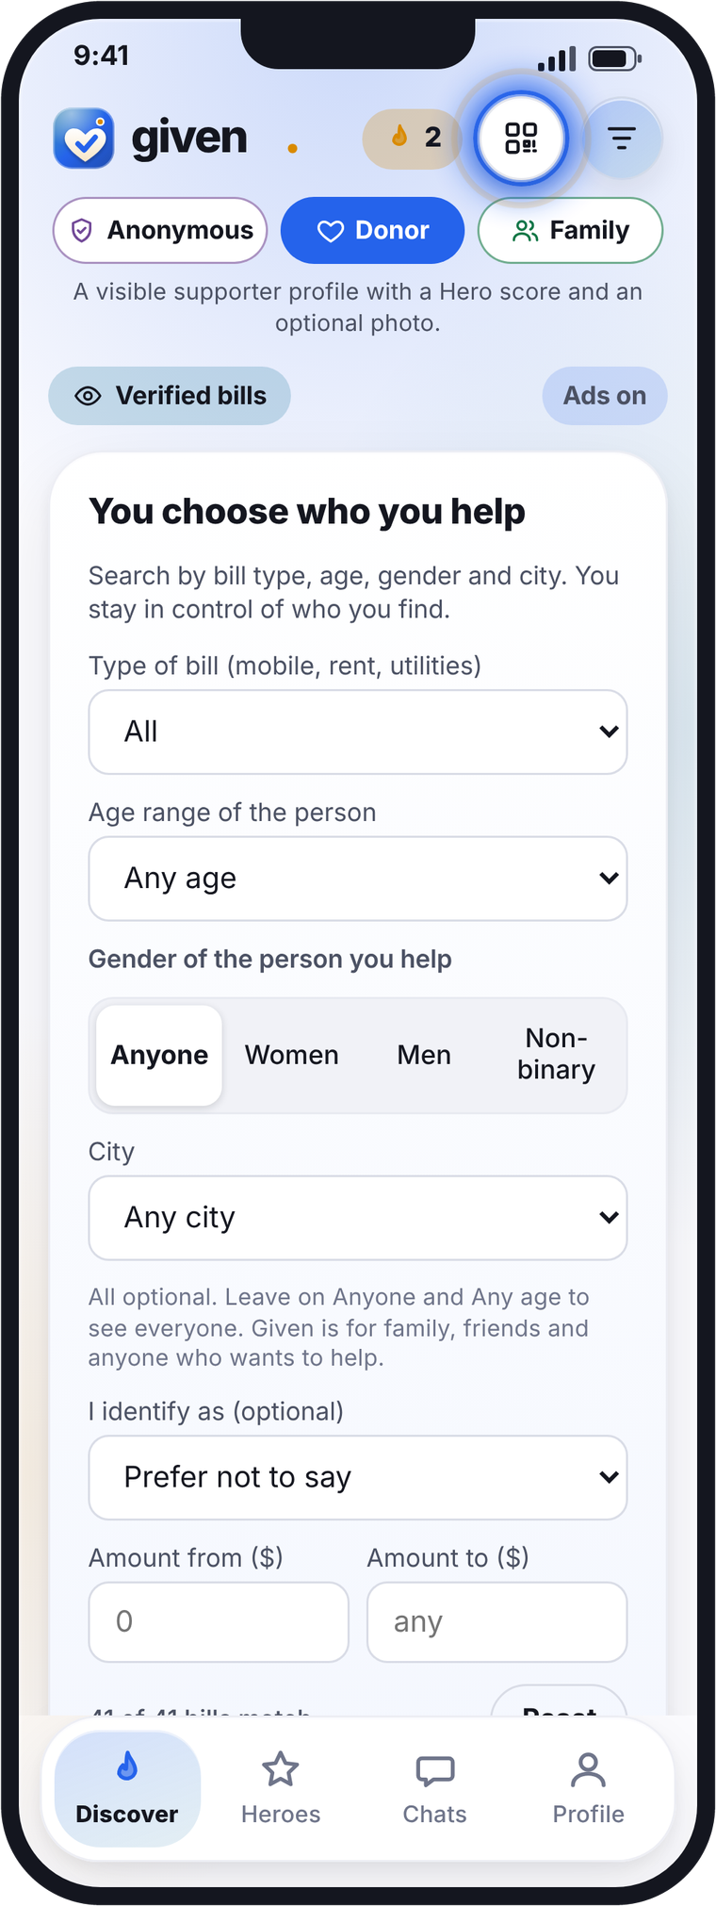
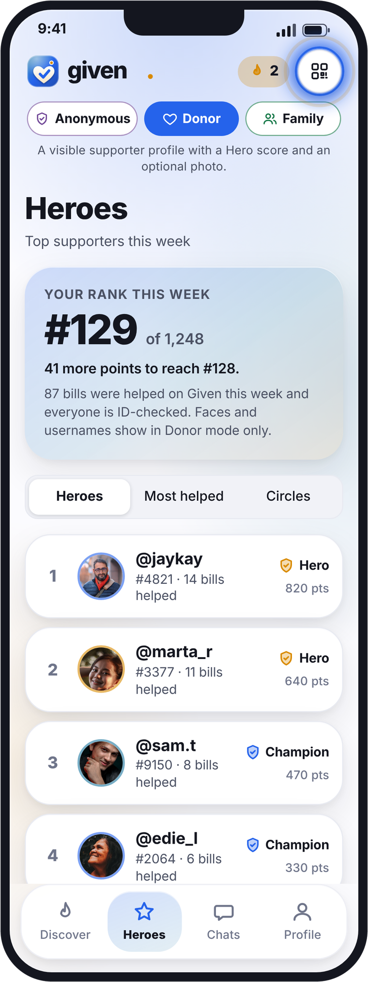
given
Sponsor benefits
What sponsors, supporters and family get when they help with rent and other bills. All of this is in the app today.
Choose who you help
Verified people
Filter by bill type, age and gender.
A verified profile and photo. Every bill checked first.
Say hello after helping
Regular rent support
Chat opens once the bill is paid, if the person says hello.
Set up a monthly plan. Pause, edit or cancel any time.
Hero points and levels
Recognition or privacy
Supporter, Champion, Hero, and the weekly Heroes board.
Be known for helping, or help in Anonymous mode.
Receipts
Family mode
Every payment has a receipt with a reference code.
Help as a family circle, with its own profile and board.
4
Notes:
Sponsor benefits, from existing app features only (Given app v3, 27 Oct 2026): search and filter by bill type, age and gender; verified face badge and photo; bills checked against the biller; chats open only when the poster says hello after being helped; regular supporter monthly plans you can pause, edit or cancel, with reminders 1, 3 or 7 days before; Hero points, levels (Supporter, Champion, Hero) and the weekly Heroes board; Anonymous, Donor and Family modes; receipts with a reference code only. Neutral, family-friendly framing: sponsors, supporters and family.

Slide 5
given
How you earn
$3 for every verified member, plus 20% of every rent and bill fee they pay through Given. Every month.
1
Every verified member
2
Every payment they make
$3
20%
paid once they pass the ID and face check
of Given's fee, every month they pay
Your link, code or QR does the work
$1,000 rent paid: $10 to you
Paid monthly, with a statement
$100 bill paid: $2 to you
Illustrative examples, not guaranteed earnings. Rates to be agreed.
5
Notes:
Example rates, to be agreed: $3 per verified member (one-off) plus 20% of Given's fee on payments by members you brought in, for as long as they keep paying. Given's fee: a flat 5% of rent, 10% of other bills. $1,000 rent: Given fee $50, partner $10 a month. $100 bill: Given fee $10, partner $2.

Slide 6
given
Try your own numbers: usegiven.com/calculator
Example: a creator with 250,000 followers
250,000
followers
5,000
join (2%)
2,500
verify (half of them)
$1,750 a month
(rent $1,250)
$7,500
one-time sign-up payments, 2,500 × $3
Illustrative examples, not guaranteed earnings. Rates to be agreed.
6
Notes:
250,000 followers. Defaults, in line with creator benchmarks: 2% of followers join (5,000) and half verify (2,500); one-time sign-up payments 2,500 × $3 = $7,500. Presets set the join rate too: Starter 1%, Growing 2%, Big 4%. Monthly share = 20% of Given's fee: rent a flat 5% of each payment, other bills 10% (2 bills a month at $100). Starter: 1,250 verified, rent $1,250 + bills $500 = $1,750 a month. Growing: 2,500 verified, rent $6,250 + bills $2,500 = $8,750 a month. Big: 5,000 verified, rent $37,500 + bills $10,000 = $47,500 a month. Rent is the biggest earner in every preset. Model: model.py partner_calc(). Calculator: https://usegiven.com/calculator/

Slide 7
given
Try your own numbers: usegiven.com/calculator
Your first 12 months
Growing preset: total earned in year 1
$7,500
$65,625
$26,250
$99,375
one-time sign-ups
rent share (monthly)
bills share (monthly)
Starter: year 1
one-time sign-ups end here
$22,125
Growing: year 1
$99,375
Big: year 1
$513,750
Months 1-3: members join and verify, so one-time $3 sign-up payments (dark) arrive while your monthly share builds up. From month 4 the monthly share holds steady.
Illustrative examples, not guaranteed earnings. Rates to be agreed.
7
Notes:
Month by month, Growing preset at 250,000 followers. Why the step: one-time sign-up payments ($7,500, $3 per verified member) are paid as members verify over months 1-3, a third each month; at the same time the share of members paying rent and bills builds 25%, 50%, 75%, then 100% from month 4. So month 3 ($9,062) is slightly higher than month 4 onwards ($8,750): the one-time payments stop and the monthly share is steady. No drop-off modelled. Year 1: Starter $22,125, Growing $99,375, Big $513,750. Then $1,750 / $8,750 / $47,500 a month.

Slide 8
given
Try your own numbers: usegiven.com/calculator
The monthly share makes the difference
Year 1 at 250,000 followers. Grey: one-time sign-ups only. Gold: sign-ups plus 12 months of shares.
One family paying rent
$1,000 a month
Given fee (5%)
$50 a month
Your share (20%)
$10 a month
Over a year
$120
Every month they keep paying, on top of the $3 sign-up.
Illustrative examples, not guaranteed earnings. Rates to be agreed.
8
Notes:
Year 1, sign-up payments only (one-time): Starter $3,750, Growing $7,500, Big $15,000. With 12 months of rent and bills share: Starter $22,125, Growing $99,375, Big $513,750. One family paying $1,000 rent a month: Given fee a flat 5% = $50, your share $10 a month, $120 a year.

Slide 9
given
Your posting plan: bonuses to unlock
Two tracks. Post more, on more platforms, and earn more.
Starter track
Partner track
Post on every platform
A one-time payment for every verified member.
A share of your members' rent and bill fees, every month.
We ask at onboarding: which platforms are you on? Post once per platform.
TikTok · Instagram · YouTube
Unlock +25%
Unlock the top rate
on every sign-up payment when you post 3 times a week.
by posting 5 days a week and joining a short monthly review call.
+10%
for 2 platforms
+20%
for all 3
Paid monthly
Taking a break?
As your members verify, with a statement.
You keep a base rate.
Weekly leaderboard, and a monthly prize for the top poster.
Illustrative. Bonuses and rates to be agreed in writing.
9
Notes:
Posting plan (to be agreed). Starter track: one-time payment per verified member; posting 3 times a week unlocks a +25% sign-up bonus. Partner track: share of members' rent and bill fees; the top rate is unlocked by posting 5 days a week plus a short monthly review call; a base rate applies during a pause. Multi-platform: onboarding asks which platforms (TikTok, Instagram, YouTube); post once per platform; stacking bonus +10% for 2 platforms, +20% for all 3; weekly leaderboard and a monthly top-poster prize. These bonuses are not included in the calculator numbers.

Slide 10
given
Pick one lane and own it
A clear niche builds trust, and trust is what gets members to pay through Given.
Rent
Bills
Generous supporters
Main lane, biggest earner
For money-saving creators
For lifestyle creators
Students, young renters and their parents.
Budgeting, deals and household tips.
Audiences who love to help others.
Rent is the largest bill most people have
Phone, utilities and internet
Supporters choose who they help
$10 a month to you for every $1,000 rent
$2 to you for every $100 bill
Family-friendly and respectful, always
Families pay it every single month
Easy, everyday content
Recognition, or help anonymously
Illustrative examples, not guaranteed earnings. Rates to be agreed.
10
Notes:
Niches: Rent is the main lane and the biggest earner (students, young renters and their parents). Bills is a secondary lane for money-saving creators. Generous supporters is a lane for lifestyle creators whose audiences like to help others; wording stays neutral and family-friendly.

Slide 11
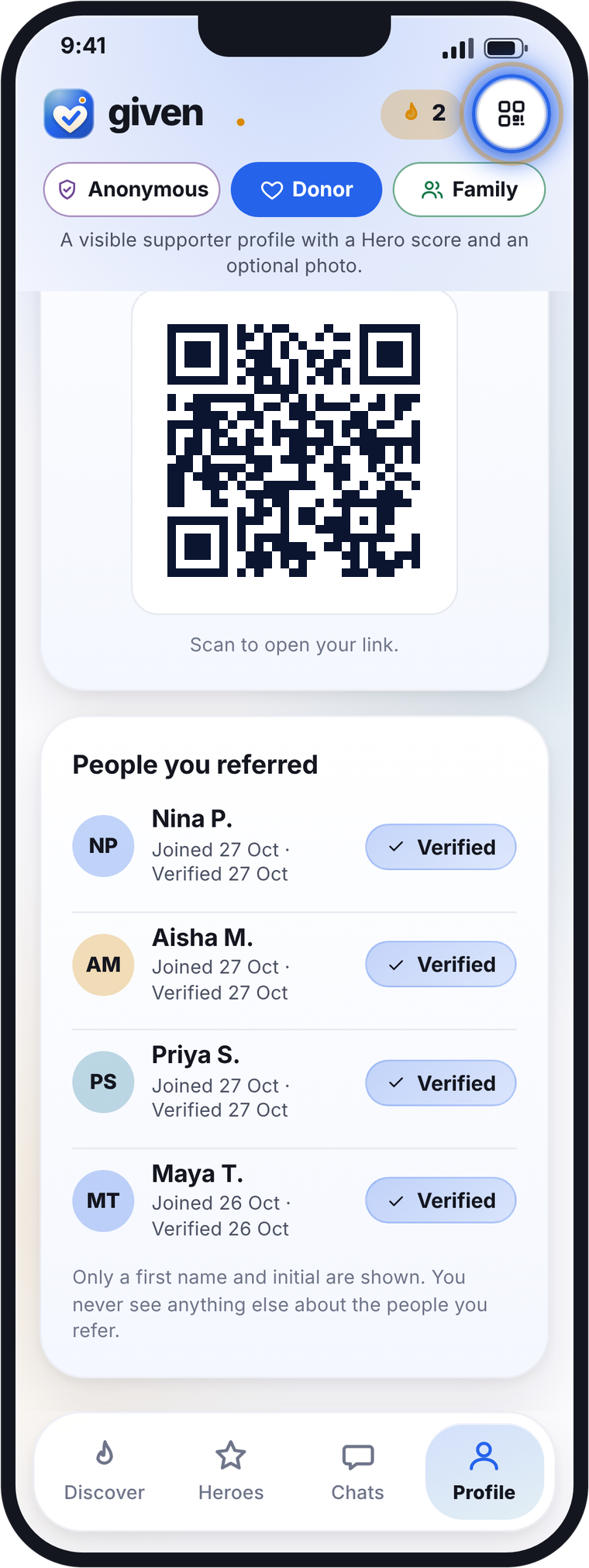
given
How tracking works
Your link, code and QR
Share them in posts, stories and your bio.
Counted in the app
The Referrals screen shows who joined and who verified.
Paid monthly
Payouts each month, with a statement.
Only real members count
Verified people and completed payments only. No fake or self-referrals.
11
Notes:
Tracking: each account has a unique referral link, code and QR code; the Referrals screen counts people who joined and who verified. Payouts monthly, only for verified real members and completed payments.

Slide 12
given
What we need from you, and next steps
What we need from you
Next steps
Share Given honestly with your own link, code or QR.
1
Book a call
usegiven.com/join/#book
Label every paid post as an ad (#ad) and follow FTC rules.
2
Run your numbers
usegiven.com/calculator
Never promise followers that a bill will be paid.
3
Pick your track and lane
Starter or Partner; rent, bills or generous supporters.
Keep it family-friendly and respectful.
4
Agree rates and get your link
Rates and bonuses in writing, then your link, code and QR.
Illustrative examples, not guaranteed earnings. Rates to be agreed.
12
Notes:
Partner obligations: own referral link, clear ad disclosure (#ad), FTC endorsement guides, no promises that bills will be paid, family-friendly content. Next steps: book a call at https://usegiven.com/join/#book, run your numbers at https://usegiven.com/calculator/, choose track and lane, agree rates and bonuses in writing, receive link, code and QR.

Slide 13



Given
The kindest way to help with a bill.
usegiven.com
Try your own numbers: usegiven.com/calculator
Scan to book a call
Illustrative examples, not guaranteed earnings. Rates to be agreed.
Notes:
Closing. QR code: book a call at https://usegiven.com/join/#book ; calculator https://usegiven.com/calculator/ ; App Store: https://apps.apple.com/app/given/id0000000000 ; Google Play: https://play.google.com/store/apps/details?id=com.usegiven.app ; website https://usegiven.com

