Slide 1
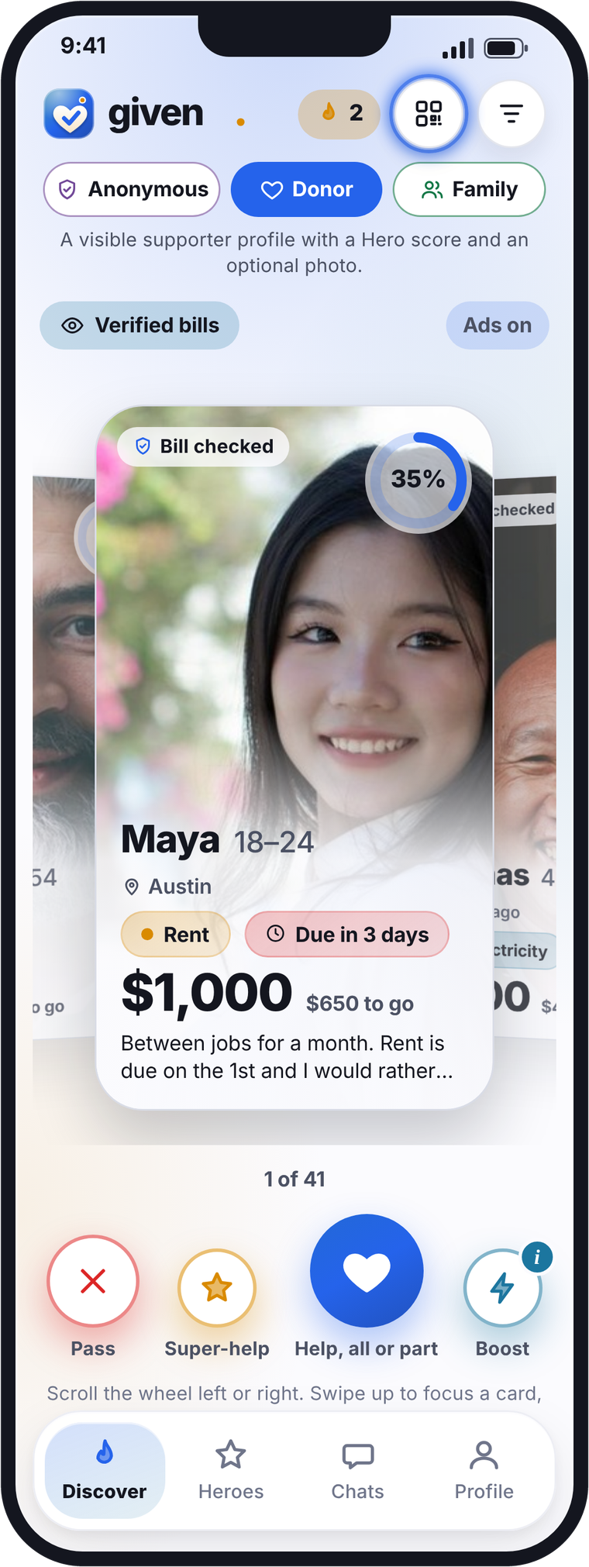
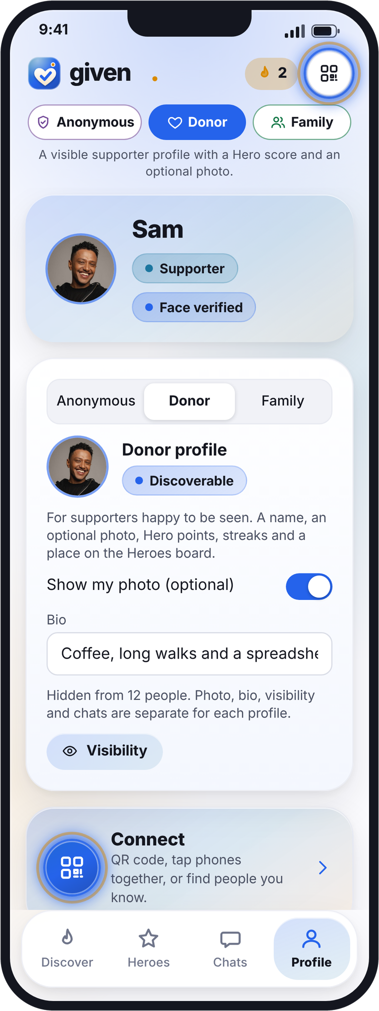

Given
The kindest way to help with a bill.
Post your bill to be verified. Supporters can choose to help, pass, or super-help. The billing company is paid. Then say hello.
Notes:
Cover. Given: the kindest way to help with a bill. Phones: Discover (Donor mode) and Profile. Source: Given app v3, screens captured 27 Oct 2026 (US dollar version); Given explainer script.

Slide 2

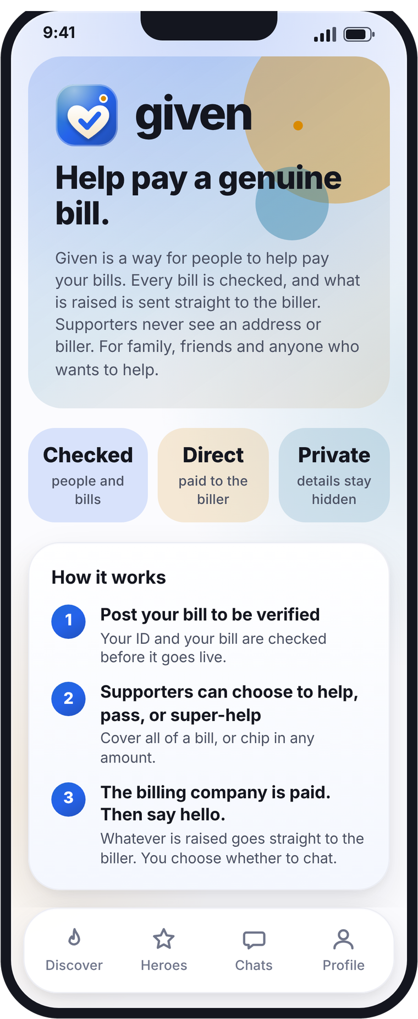
given
Post a bill. Supporters help. The billing company is paid.
1
Post your bill to be verified.
Upload the bill. Your ID and the bill are checked before it goes live.
2
Supporters can choose to help, pass, or super-help.
They see a category and an amount, and can help with all of it or just part.
3
The billing company is paid. Then say hello.
Whatever is raised goes straight to the billing company. You choose who to say hello to.
2
Notes:
How it works. The three steps match the app's About Given screen: post your bill to be verified; supporters can choose to help, pass, or super-help; the billing company is paid, then say hello. Source: Given app v3, screens captured 27 Oct 2026 (US dollar version); Given explainer script.

Slide 3
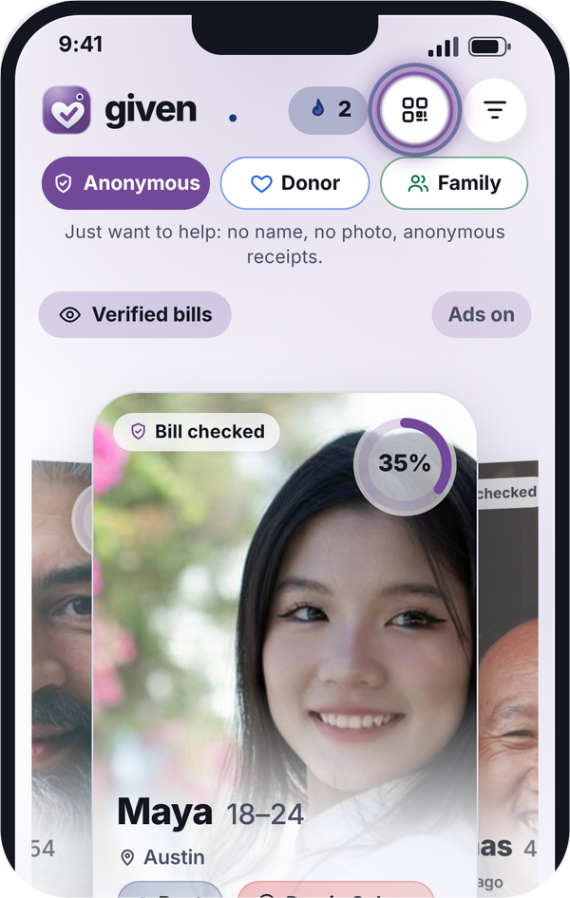
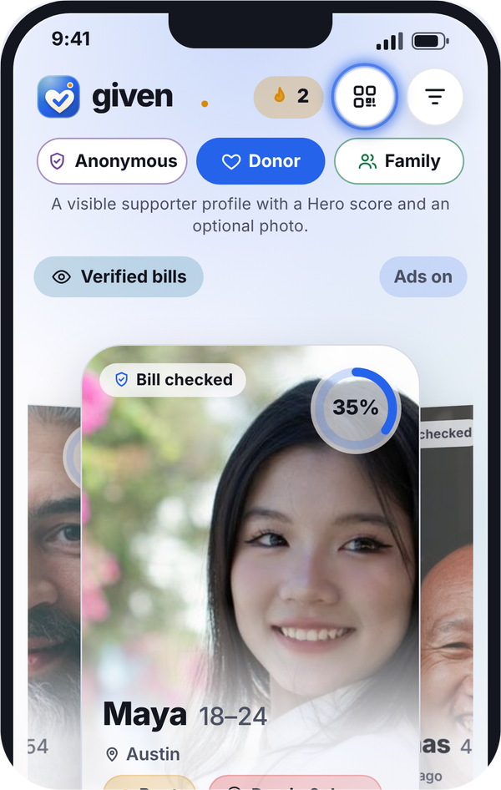
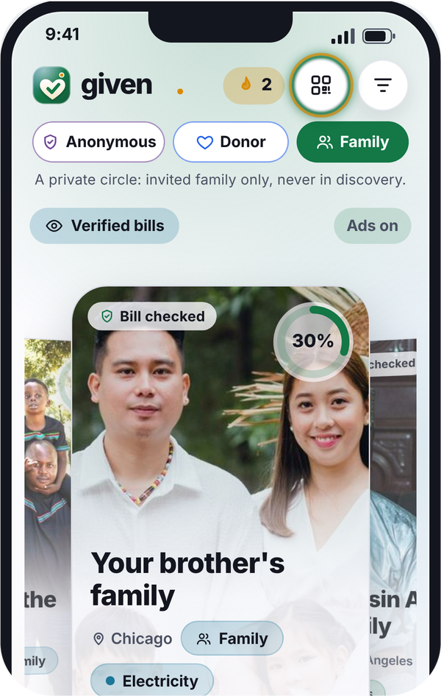
given
Three ways to show up
Switch mode any time. Photo, bio, visibility and chats are separate for each mode.
Anonymous
Donor
Family
No name, no photo, anonymous receipts. Others see a reference code only.
A visible profile: a name, an optional photo, Hero points and a place on the Heroes board.
An invite-only private circle, never shown in discovery, with its own chats.
3
Notes:
Three modes from the app's mode switch and Features section: Anonymous (no name, no photo, anonymous receipts; others see a reference code only), Donor (a visible supporter profile with a name, an optional photo, Hero points, streaks and a place on the Heroes board), Family (an invite-only private circle, never shown in discovery, with its own chats). The three cards are the same size. Source: Given app v3, screens captured 27 Oct 2026 (US dollar version); Given explainer script.

Slide 4
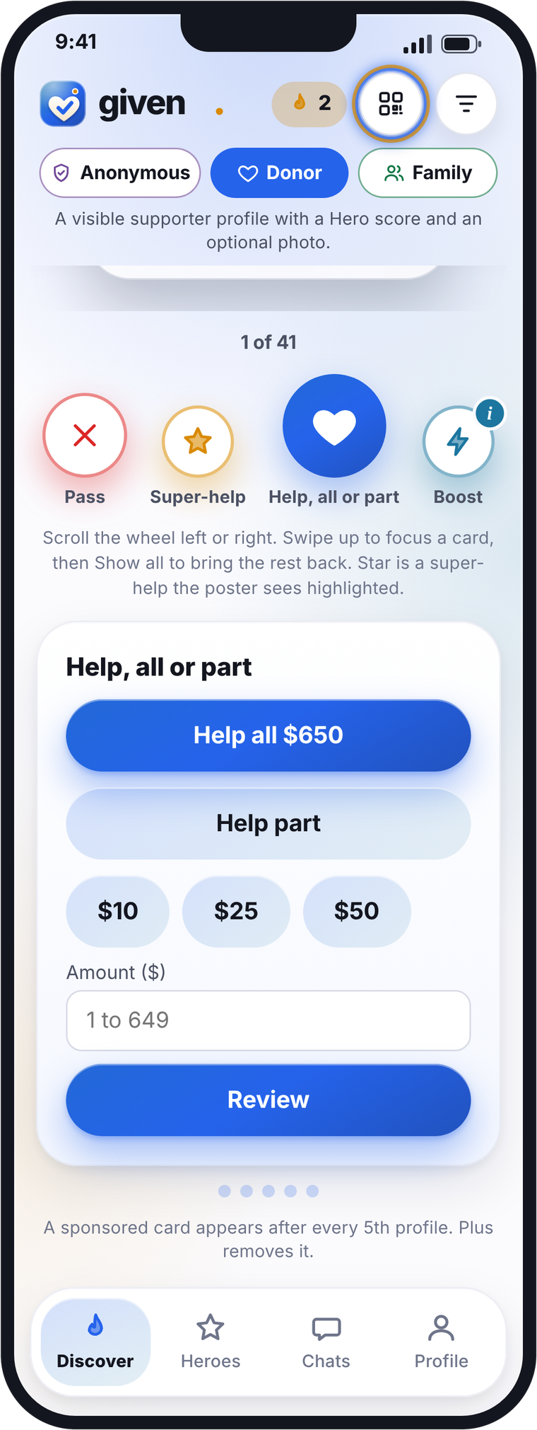




given
Help, Pass or Super-help
Swipe through checked bills. Each card shows a bill type, an amount and what is left to go.
Help, all or part
Help with the whole bill, or just part of it.
Pass
Not for you? Move on to the next person.
Super-help
A help the poster sees highlighted.
Boost puts your message first in the poster's inbox. The poster chooses whether to say hello. Nothing is owed either way.
4
Notes:
Buttons from the app's Discover screen: Pass, Super-help, Help, all or part, Boost. Help, all or part opens a short sheet: Help all (the whole amount left) or Help part (quick amounts such as $10, $25, $50, or any amount), then Review. Phones: Discover and the Help, all or part sheet; Pass moves on to the next person; Super-help is a help the poster sees highlighted; Boost puts your message first in the poster's inbox; the poster chooses whether to say hi, pass or block, nothing is owed either way. Source: Given app v3, screens captured 27 Oct 2026 (US dollar version); Given explainer script.

Slide 5
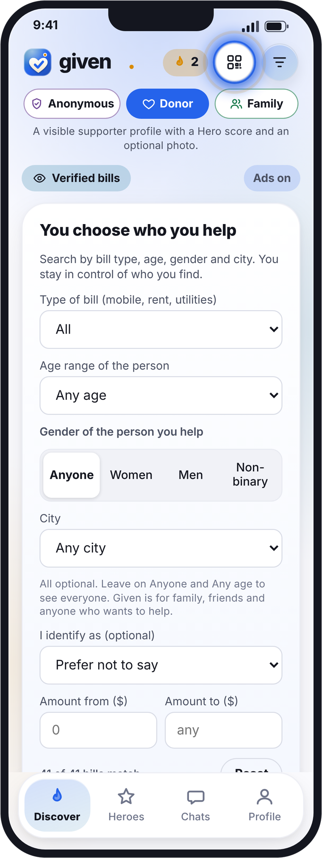
given
You choose who you help
Search and filter to find the people and bills you want to help with. Family friendly, and you stay in control.
1
Type of bill
2
Age of the person
Mobile, rent or utilities: electricity, gas, water, broadband.
Any age, younger (18 to 39), older (40+), or an exact age range.
3
Gender of the person
4
Amount
Anyone, women, men or non-binary. Optional: Anyone is the default.
Set a from and to amount for the bill.
5
Notes:
Filter and search from the app ('You choose who you help'): donors search by type of bill (mobile, rent, utilities: electricity, gas, water, broadband), age of the person (any age, younger 18-39, older 40+, or an exact age), gender of the person they help (anyone, women, men, non-binary; optional, Anyone is the default) and amount. Source: Given app v3, screens captured 27 Oct 2026 (US dollar version); Given explainer script.

Slide 6
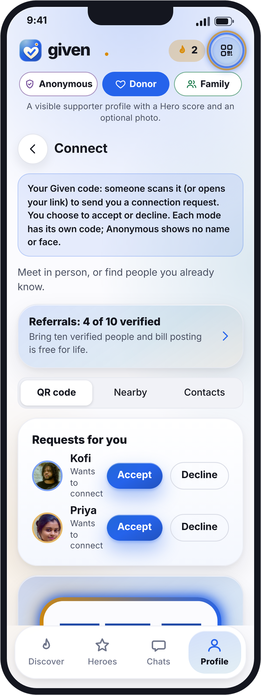
given
Connect in seconds
Meet in person, or find people you already know.
QR code
Nearby
Show your code, or scan someone else's.
Hold two phones together to pair.
Contacts
WhatsApp
Find people you know. Opt-in for each mode.
Send your link to a chat in one tap.
Link in bio
Always a request
Anyone can open it and help, no app needed.
The other person accepts every connection.
6
Notes:
Connect from the app's Connect screen and Features section: QR code, Nearby (hold phones together), Contacts (opt-in per mode), WhatsApp, link in bio (anyone can open it and help, no app needed). Every connection is a request that the other person accepts. Source: Given app v3, screens captured 27 Oct 2026 (US dollar version); Given explainer script.

Slide 7
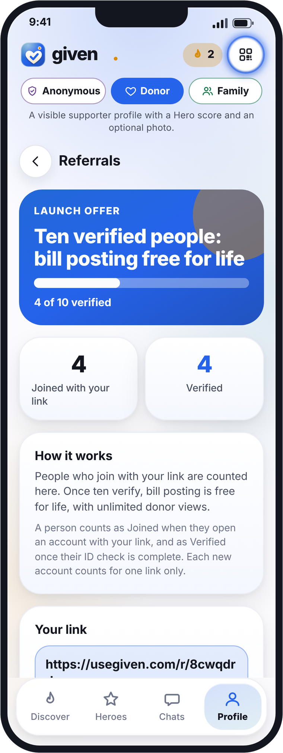
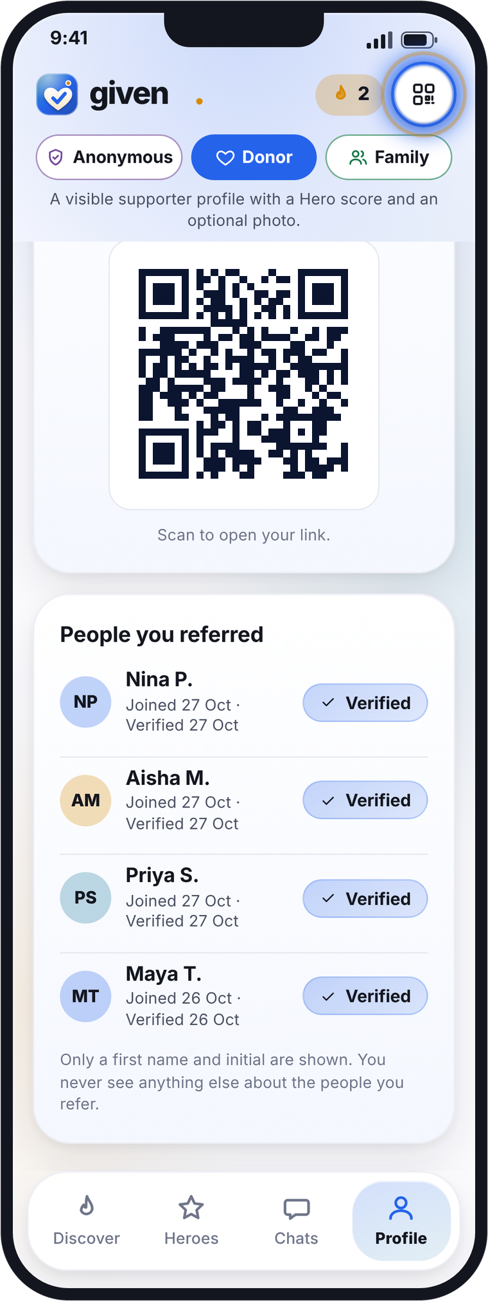
given
30-day launch offer
10
verified people, bill posting free for life, unlimited donor views.
Your own link and QR code
Every account gets a unique link, a code and a QR code to share.
Counted in the app
The Referrals screen counts who joined and who verified.
Private by design
You see a first name and initial, with Joined or Verified and the date.
7
Notes:
Referrals from the app and REFERRALS.md: each account gets a unique link, code and QR code; the Referrals screen counts people who joined and people who verified; ten verified people, bill posting free for life, unlimited donor views (30-day launch offer); the referrer sees only a first name and initial, status and dates. Phones: Referrals (progress to ten) and the lower half (QR code, people you referred). Source: Given app v3, screens captured 27 Oct 2026 (US dollar version); Given explainer script.

Slide 8
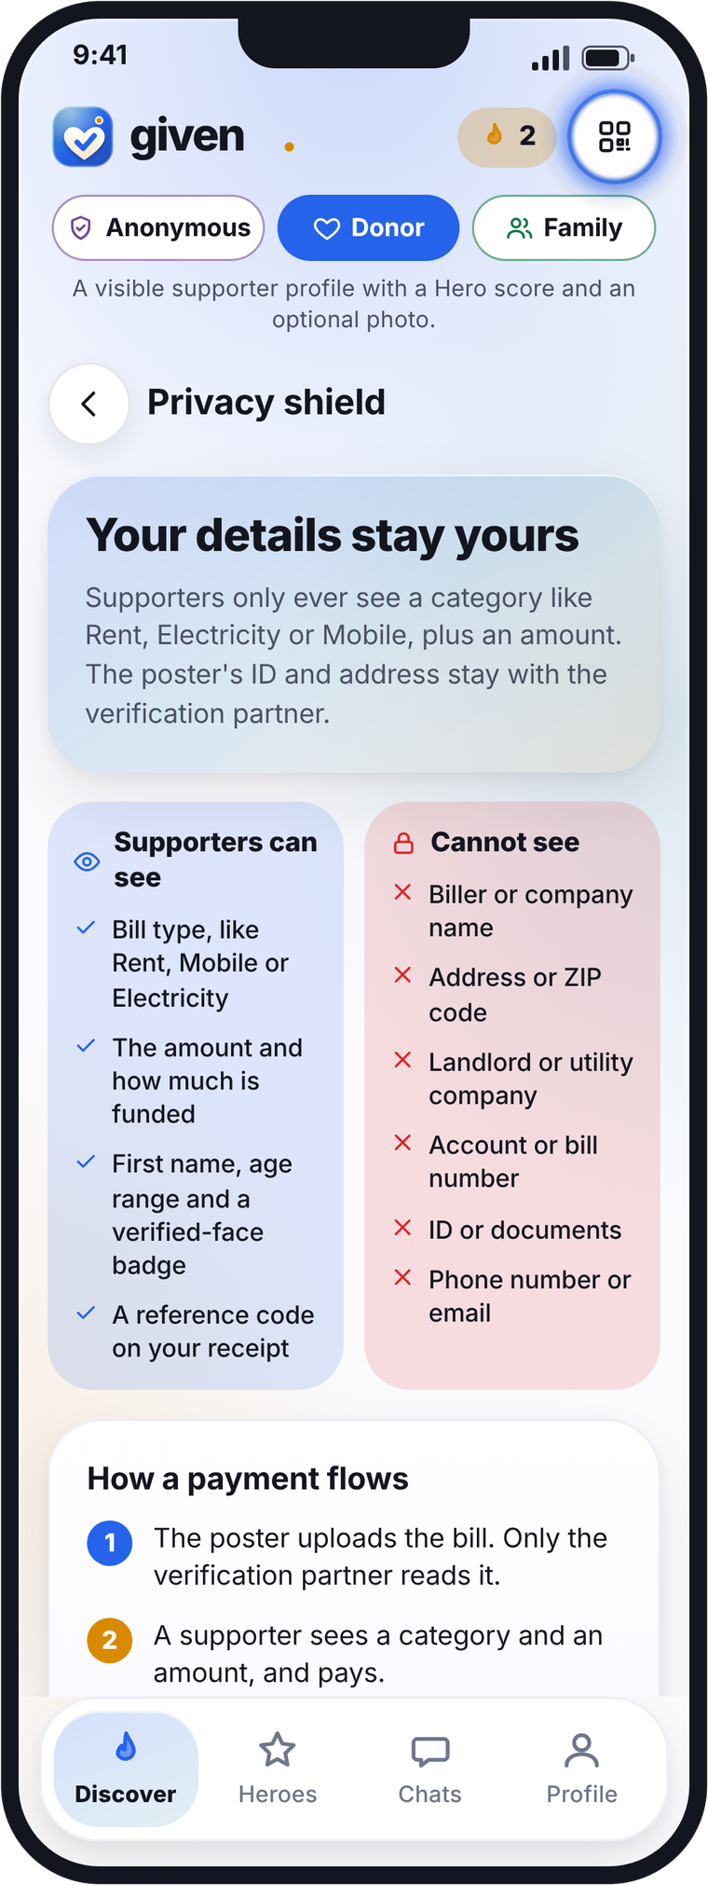
given
Your details stay yours
Supporters only ever see a bill type and an amount.
Supporters can see
Supporters never see
✓ Bill type, like Rent or Mobile
× Biller or company name
✓ The amount and how much is funded
× Address or ZIP code
✓ First name, age, verified badge
× Landlord or utility company
✓ A reference code on the receipt
× Account or bill number
× ID or documents
× Phone number or email
Visibility is set for each mode: Hidden, Link-only or Discoverable.
8
Notes:
Privacy from the app's Privacy shield screen: supporters can see the bill type, the amount and how much is funded, first name, age and a verified-face badge, and a reference code on the receipt; they cannot see the biller or company name, address or ZIP code, landlord or utility company, account or bill number, ID or documents, phone number or email. Visibility per mode: Hidden, Link-only (never in discovery) or Discoverable. Source: Given app v3, screens captured 27 Oct 2026 (US dollar version); Given explainer script.

Slide 9
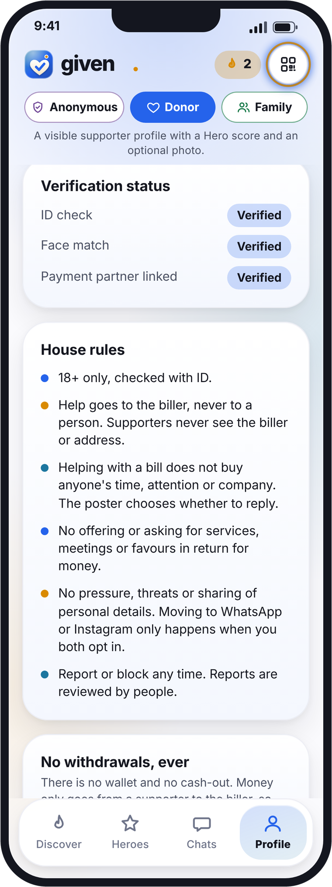
given
No fake bills. Paid straight to the biller.
Money goes to the biller, never to a person.
1
2
3
4
Verified people
Checked bill
Safe payments
To the biller
Government ID and a live selfie. 18+ only.
Each bill is checked against the biller first.
Payments go through a licensed payment partner.
Whatever is raised is sent straight to the biller.
People send what they can. Whatever is raised is sent straight to the biller.
No wallet and no cash-out. Receipts show a reference code only.
9
Notes:
Trust and payments from the app's Features section and Profile: a verification partner checks a government ID and matches a live selfie; 18+ only; each bill is checked against the biller before it goes live; payments go through a licensed payment partner straight to the biller, never to a person; whatever has been raised by the bill's deadline is sent to the biller; there is no wallet and no cash-out; receipts show a reference code only. Phone: Profile verification status and house rules. No payment partner is named or signed. Source: Given app v3, screens captured 27 Oct 2026 (US dollar version); Given explainer script.

Slide 10
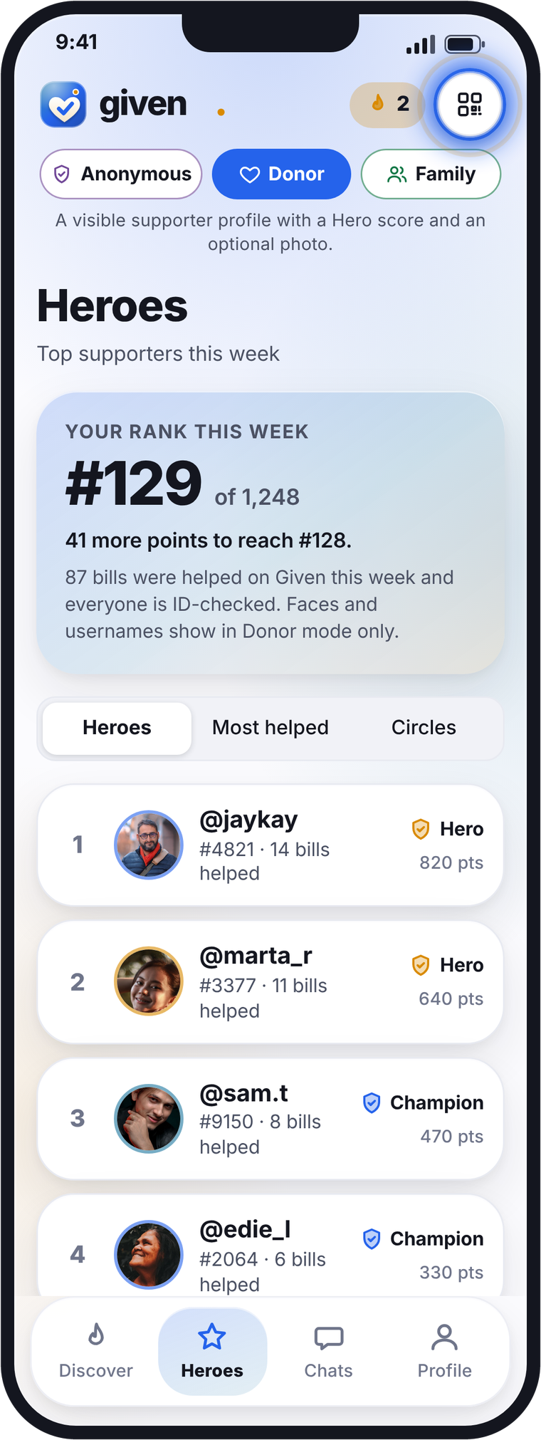
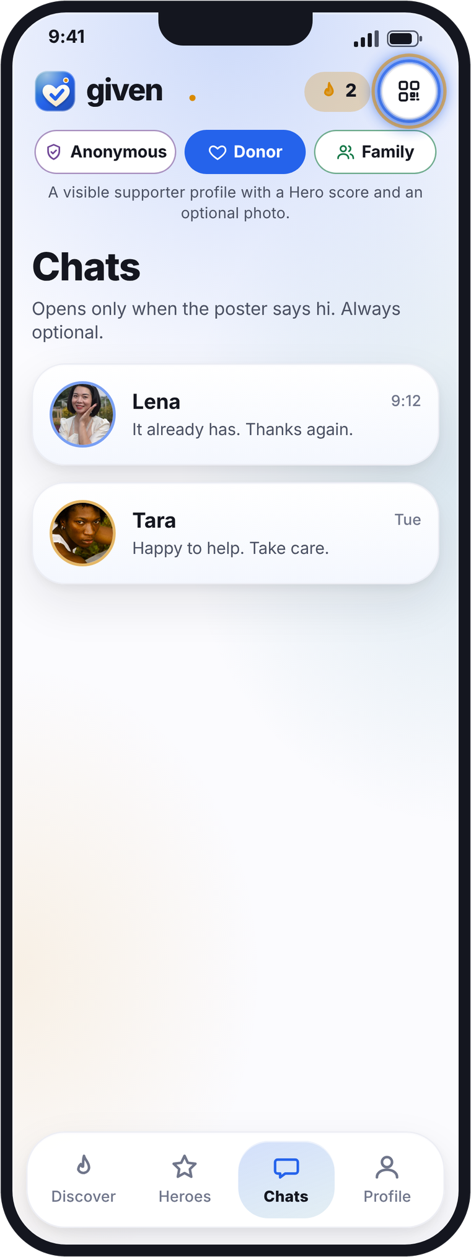
given
A bill becomes a chat. A chat becomes a friend.
After you help, the poster can say hello. Chats open only when they do.
Hero points
For every bill you help cover.
Levels
Supporter, Champion, Hero.
Heroes board
Weekly ranks for people and family circles.
10
Notes:
Friends and Heroes from the app: Chats open only when the poster says hi, always optional; Heroes board with weekly rank and Heroes / Most helped / Circles tabs; levels Supporter, Champion, Hero. Source: Given app v3, screens captured 27 Oct 2026 (US dollar version); Given explainer script.

Slide 11
given
Features
What Given does today.
Three modes
You choose who you help
Help, Pass, Super-help, Boost
Anonymous, Donor and Family, each with its own photo, bio, visibility and chats.
Search by bill type, age, gender and city, and filter by amount.
Help, all or part: the whole bill or just part. The poster chooses whether to say hello.
Connect
Repeat bills
Referrals
QR code, Nearby, Contacts, WhatsApp and a link in your bio.
Regular monthly supporters, reposting and reminders 1, 3 or 7 days before.
Your own link, code and QR. Ten verified people: bill posting free for life.
Verified and checked
Payments
Privacy and visibility
ID and live selfie checks, 18+ only. Every bill checked against the biller.
Through a licensed partner, straight to the biller. Fee and total shown first.
Bill type and amount only. Hidden, Link-only or Discoverable per mode.
11
Notes:
Current features, from the Features section of the Given app page ('What Given does today'). Repeat bills: regular supporter monthly plans you can pause, edit or cancel; repost a bill for next month; reminders 1, 3 or 7 days before. Payments: you see the amount, the service fee and the total before you confirm. Source: Given app v3, screens captured 27 Oct 2026 (US dollar version); Given explainer script.

Slide 12


Given
The kindest way to help with a bill.
usegiven.com
Try the app
Opens in your browser
Notes:
Closing. Official App Store and Google Play badges (Apple developer.apple.com badge SVG; Google Play badge vector), hyperlinked. Links: https://usegiven.com ; App Store https://apps.apple.com/app/given/id0000000000 ; Google Play https://play.google.com/store/apps/details?id=com.usegiven.app ; the Try the app button opens the web app.

